Slide 1
Sympathetic Division of Autonomic Nervous System

Slide 2
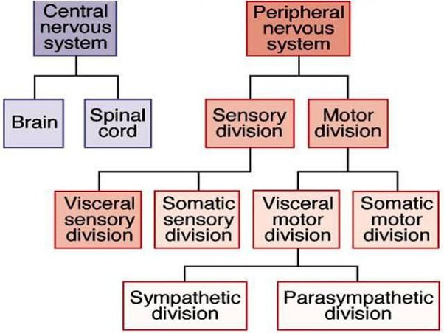
Nervous system division

Slide 3
PNS
PNS can be subdivided into sensory (afferent)
nerves and motor (efferent) nerves.
--Sensory nerves
send nerve impulse from the body to CNS to
effector organs.
-- Motor nerves are divided into the somatic nervous
system (SNS) which regulates the voluntary
contraction of the skeletal muscles, and autonomic
nervous system (ANS) which regulates the
involuntary control of smooth, cardiac muscles and
glands.

Slide 4
The sympathetic nervous system
Generally stimulates the effector organ (except in digestive tract)
It is activated in emergencies, flight– or– fight reaction, in the sense that the body can either quickly flee or "take a stand.The sympathetic nervous system is part of the autonomic nervous system, along with its counterpart parasympathetic nervous system.
The origin of the sympathetic nervous system is found within the thoracic and lumbar segments of the spinal cord also known as the thoracolumbar division (T1 to L2,3).

Slide 5
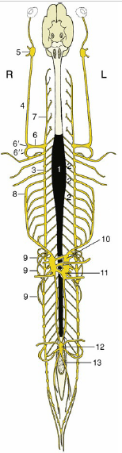
Origin and distribution of the sympathetic nervous system .
1, Sympathetic outflow from T1 toL3
2, communicating branches;
3, and 4, sympathetic trunk;
5, cranial cervical ganglion;
6,cervicothoracic ganglion;
6¢, middle cervical ganglion;
6², ansa subclavia;
7, vertebral n.;
8, greater splanchnic n.;
9, lesser splanchnic nn.;
10, celiac ganglion;
11, cranial mesenteric ganglion;
12, caudal mesenteric ganglion;
13, hypogastric n,

Slide 6
General sympathetic pathway
The sympathetic pathway can be divided into three following components:
-The preganglionic neurons.
-The sympathetic ganglia.
-The postganglionic neurons.

Slide 7
*The preganglionic neurons are located inside the thoracic and lumbar segments (T1-L2,3) of the spinal cord and their fibers (axons), which are called preganglionic fibers. These preganglionic fibers synapse with the postganglionic neurons inside the sympathetic ganglia, which are typically found near the vertebral column. These ganglia are actually a collection of cell bodies of postganglionic neurons.
The postganglionic neurons give off long axons (postganglionic fibers) that leave the ganglia and project onto visceral effectors, where they release the neurotransmitter norepinephrine.

Slide 8
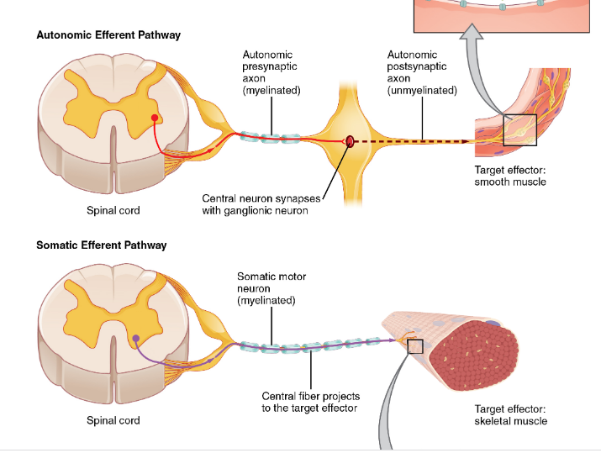

Slide 9
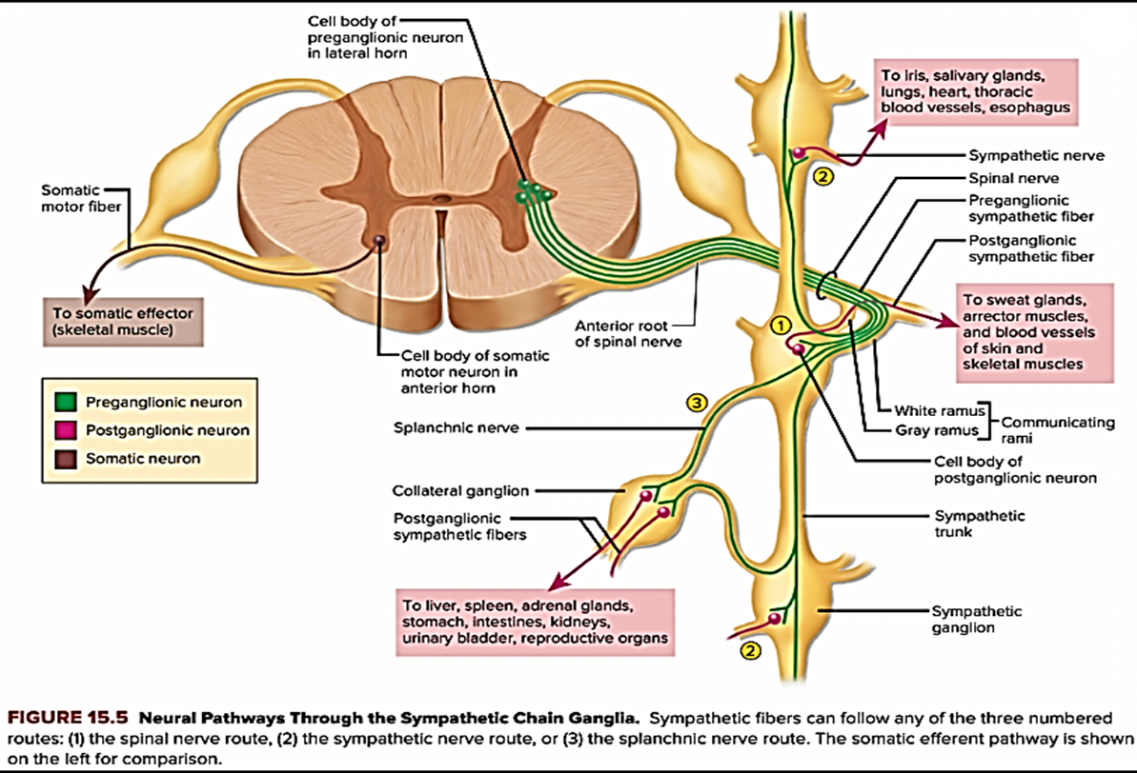
The preganglionic axons of the sympathetic system originate from sympathetic preganglionic neurons located in the lateral gray column thoracolumbar part of the and pass into the ventral roots of the thoracic and first several lumbar nerves. They continue into the spinal nerves and then leave the ventral rami, becoming the myelinated communicating branches
spinal cord

Slide 10
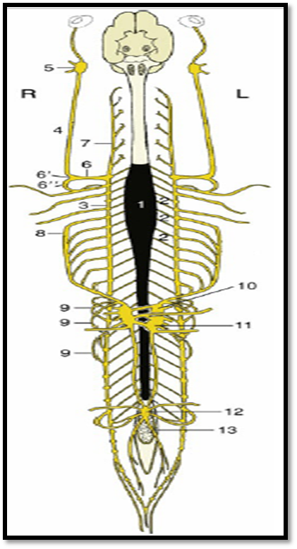
which join the ganglia of the sympathetic trunk and These bilateral trunks run the length of the neck and back, and each has a segmental arrangement, although strict correspondence of the ganglia with spinal nerves is evident only in the thoracic and cranial lumbar regions.
The cervical part of the trunk begins at the large, spindle-shaped, cranial cervical ganglion placed
close to the base of the skull .

Slide 11
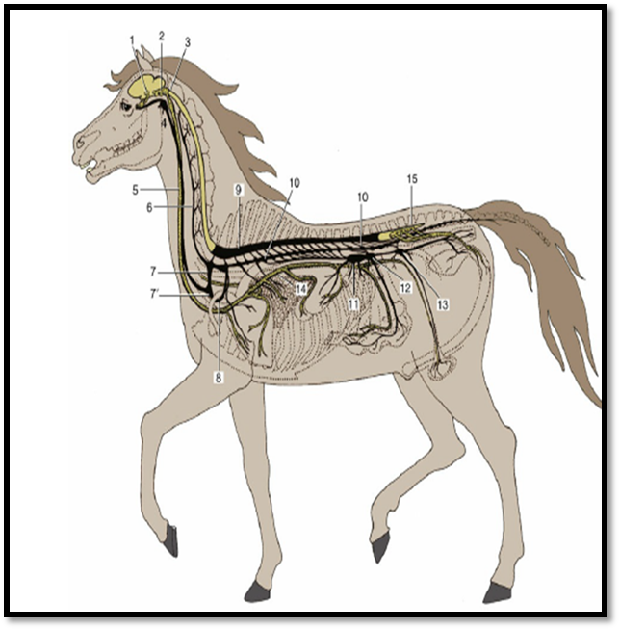
The cervical trunk is associated with the vagus within the carotid sheath and forms the vagosympathetic trunk that proceeds down the neck. Whereas the vagus contains parasympathetic axons travelling caudally to innervate thoracic and abdominal viscera, the sympathetic trunk in the neck contains sympathetic axons travelling cranially to innervate structures of the head. The two components part company at the entrance to the chest, where the sympathetic trunk often bears a middle cervical ganglion by the first rib

Slide 12
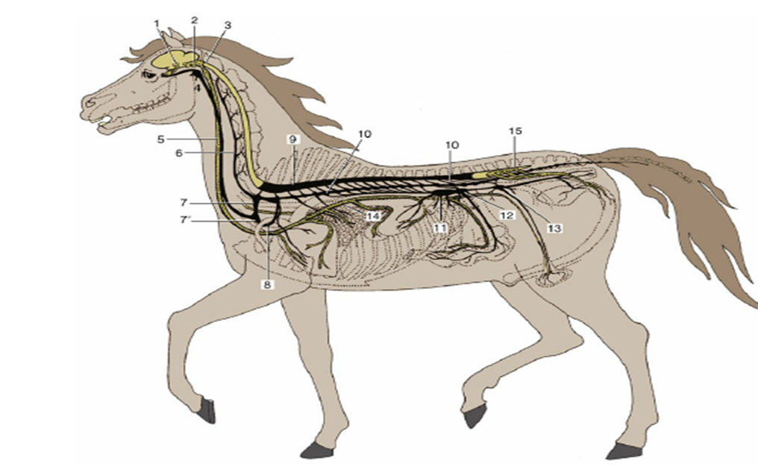
The thoracic part of the sympathetic trunk then continues subpleurally, over the line of the
costovertebral articulations, before passing dorsal to the diaphragm to enter the abdomen. Its
thoracic part contains regularly spaced ganglia, although the first one or two are fused with caudal
cervical ganglia to form the large cervicothoracic ganglion deep to the head of the first rib .

Slide 13

The lumbar part of the trunk, which lies between the psoas musculature and vertebral bodies, at first also carries a regular arrangement of ganglia, but the arrangement later becomes more erratic in that some caudal lumbar ganglia split into two or, less commonly, fuse with their neighbors. The sacral part is even less regular, and right and left trunks may fuse, temporarily or
finally, before extending into the tail, where it rapidly fade.

Slide 14
Several alternative fates are possibly with the preganglionic sympathetic fibers that enter the sympathetic chain and projection many ganglion cells:.
*Some fibers synapse immediately within the local ganglion
*others run cranially or caudally within the trunk to synapse within
ganglia.
*others pass uninterruptedly through the trunk to proceed to a second set of (prevertebral) ganglia placed about the origin of the visceral branches of the abdominal aorta.

Slide 15
This last group constitutes the splanchnic nerves, which are rather variable in arrangement; usually one greater splanchnic nerve is formed by preganglionic fibers that leave the trunk from about the sixth to the penultimate thoracic ganglia, with lesser splanching and lumbar splanchnic nerves arising at more caudal levels.

Slide 16
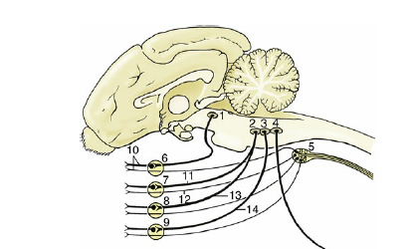
The viscera and vessels of the head receive their sympathetic innervation via:
- cranial cervical ganglion.
-follows the internal carotid artery into the cranial cavity and join various nerves, especially the trigeminal and those to the extraocular muscles.
-fibers passes through the ciliary ganglion to the eyeball for dilator pupillae.
-the internal carotid nerve gives off the deep petrosal nerve, combines with the greater petrosal nerve that supply structures within the orbit, nasal cavity, sinuses, and palate.

Slide 17
.
The thoracic organs—heart, trachea, and lung are supplied by postganglionic fibers that form cardiac and pulmonary plexuses within the mediastinum after leaving the thoracic portion of the sympathetic trunk. These plexuses combine with the corresponding parasympathetic component.

Slide 18
The abdominal and pelvic organs receive their sympathetic innervation through the *various splanchnic nerves that lead to the celiac, cranial mesenteric, renal, aorticorenal, gonadal, and caudal mesenteric ganglia placed on the ventral face of the aorta by the origins of the visceral arteries.
*The preganglionic fibers synapse in these ganglia, and the postganglionic fibers that emerge from intricate plexuses (combining vagal contributions) and run parallel to, the visceral arteries.

Slide 19
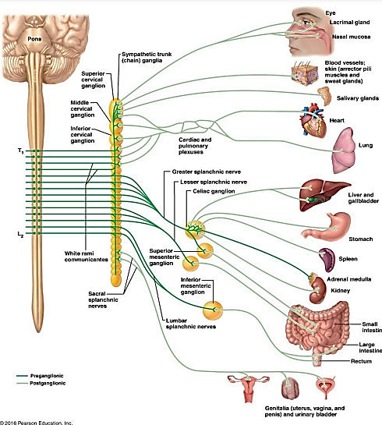

Slide 20
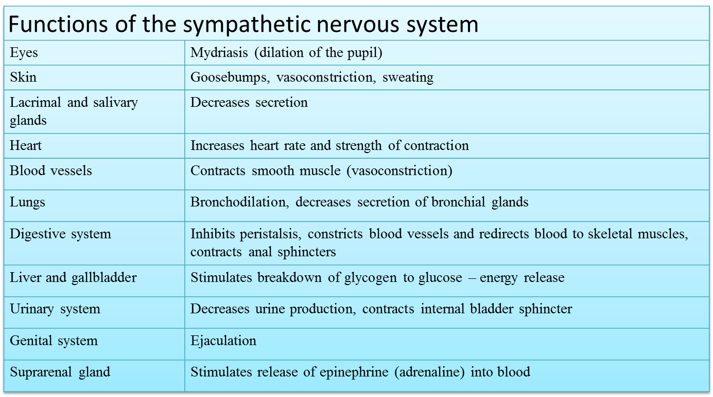

Slide 21
Thank you

